Slide 1


Slide 2
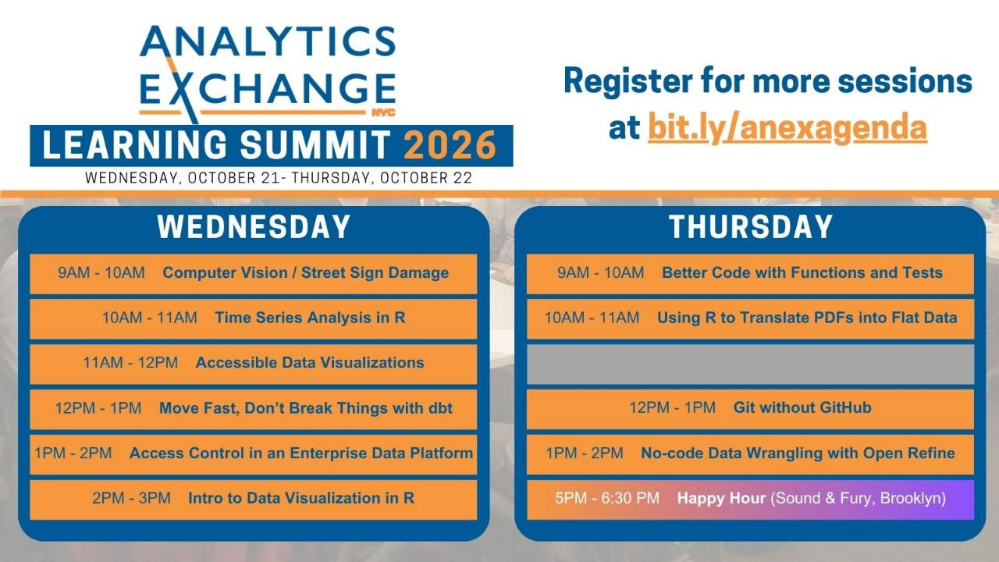

Slide 3
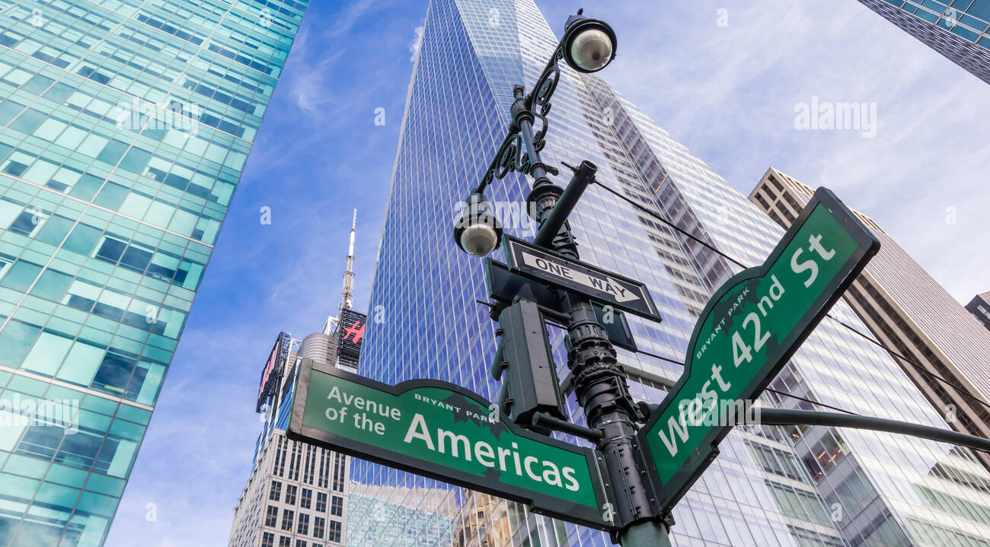
DETECTING STREET NAME SIGNS DETERIORATION USING COMPUTER VISION
Karim Nabahi and Maddalena Romano, October 21, 2026
Prepared for the 2026 Learning Summit, Office of Technology and Innovation

Slide 4
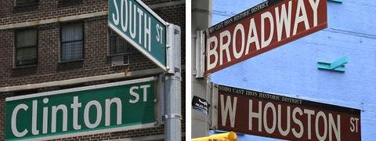
The Issue
165,000+ signs across 45,000+ intersections
Relies on field inspection/public reporting
Reactive instead of proactive

Slide 5
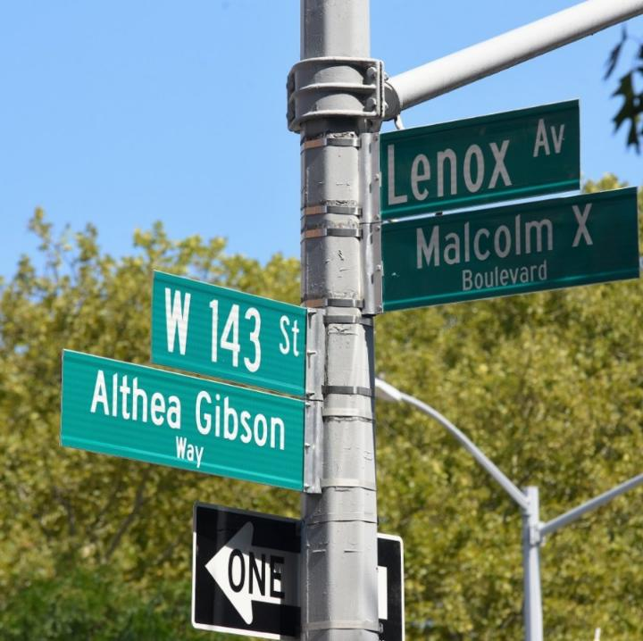
Our Solution
Automate detection of damaged signs
Build Pipeline with Cyclomedia + sign inventory
Report location, damage type of flagged signs
Notes:
G1: Automate detection of damaged street name signs, freeing up limited field-inspection staff.
Phase 1: Create a tool to manually annotate signs, and review reports; begin testing automated option
Phase 2: Use automatic tool to retrieve and flag signs, then be able to review detections and keep improving model accuracy
G2: Combine Cyclomedia street-level imagery with NYC Open Data's existing sign inventory to build a pipeline that automatically flags repairs needed.
Phase 1: Use Cyclomedia to fetch images based on area -> retrieve panoramas of each intersection within CB
Phase 1 bis: Match signs to SIMS entries to facilitate future SIMS integration
Phase 2: Retrieve best angle for each sign; fully trained model that uses Cyclomedia
G3: Report each flagged sign's location and damage type.
Phase 1: Record SIMS data along sign location and reported or flagged damage type
Phase 1 bis: Create a DB for easy review and queries
Q: Do they want a DB?
G4: Deliver an interactive spatial webview plus a dataset formatted for future SIMS ingestion.
Phase 1: local hosted Webview to reject/approve reported damage
Phase 2: server hosted webview to help guide DOT to fixing damage based on priority, review old/already reviewed CBs reports, request reports on CBs
Q: Do you want just a simple spreadsheet that you can share?

Slide 6
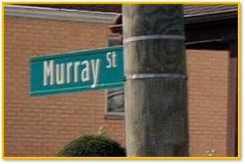
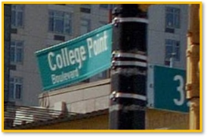
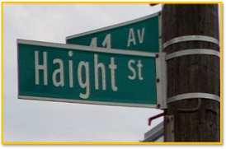
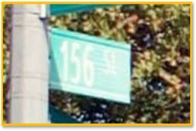
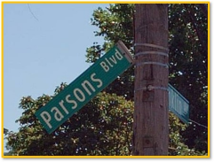
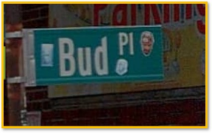
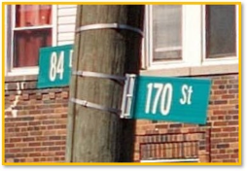
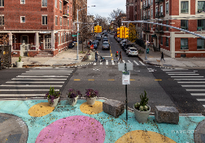
Damage Types
Missing
Bent/Damaged
Old Design
Faded
Incomplete Intersections
Hanging
Vandalized
Reflagged

Slide 7

Demo
Please download the zip file, and extract it to your Downloads folder.
https://github.com/mromano1/StreetNameSigns/tree/main/LearningSummit2026Demo
Please make sure you have Python 3.11 or higher installed.

Slide 8
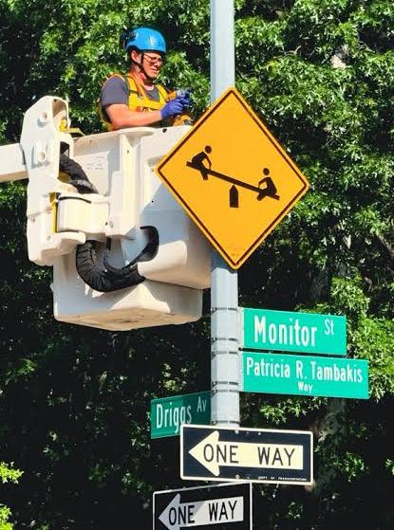
Thank You
Questions?
Karim Nabahi: karim@nabahi.com
Maddalena Romano: mromano1@dot.nyc.gov

